Slide 1
CRAVING!
...because getting to the root of the problem is the solution...
Team 4:
Akshay Pesari, Irina Sachovska, Midhuna Manchi, Onyekachi Ohiaeri, Shubham Trivedi, Tejashri Parurkar

Slide 2

GitHub URL: https://github.com/Midhuna-Manchi/Craving

Slide 3

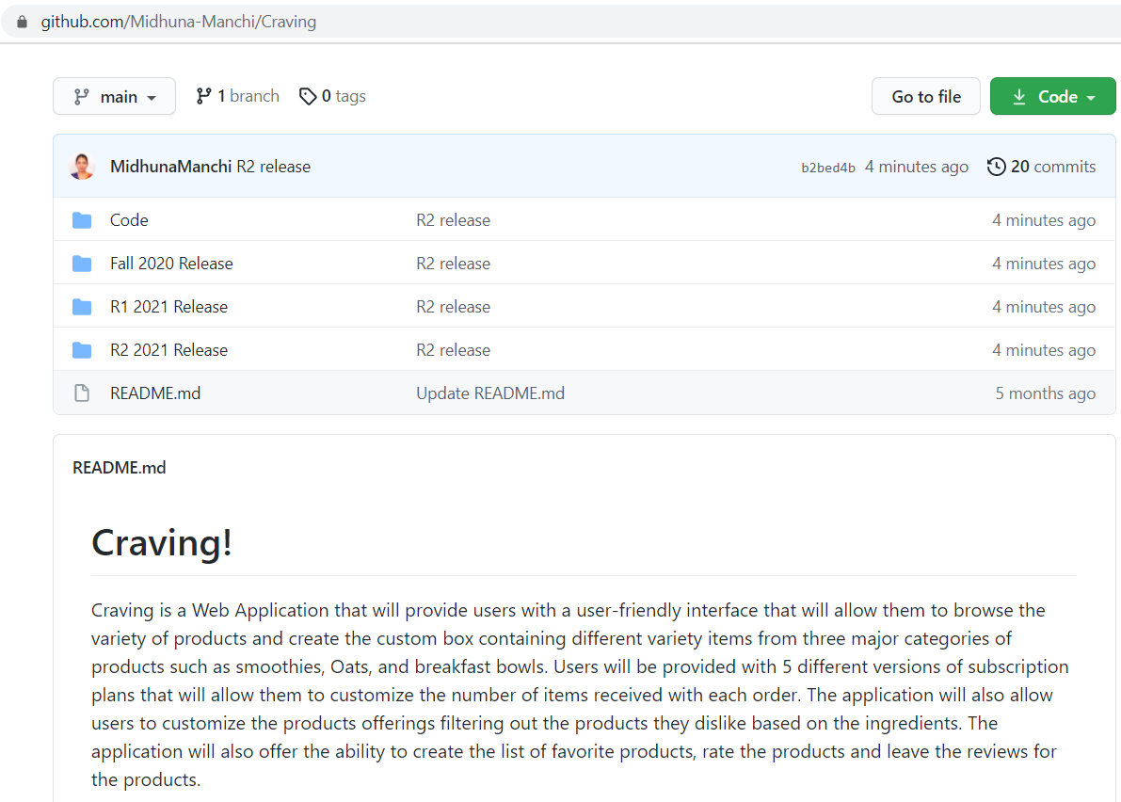
Repository Structure

Slide 4
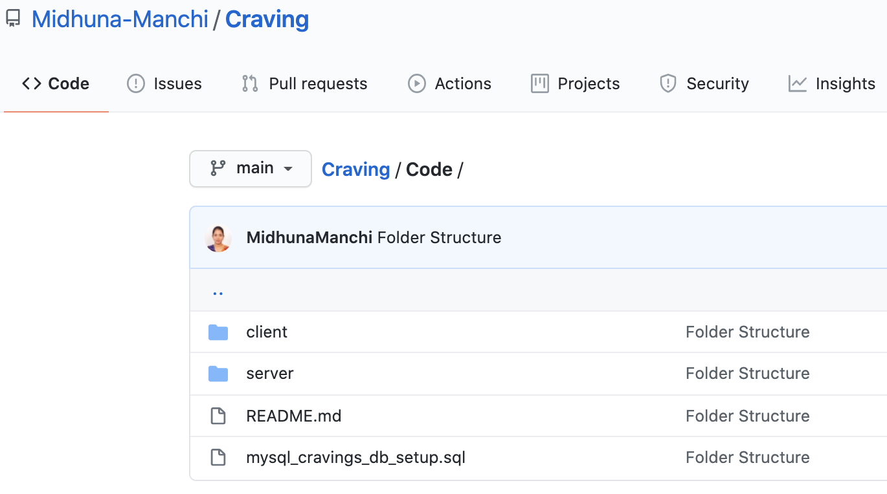
Repository Structure

Slide 5

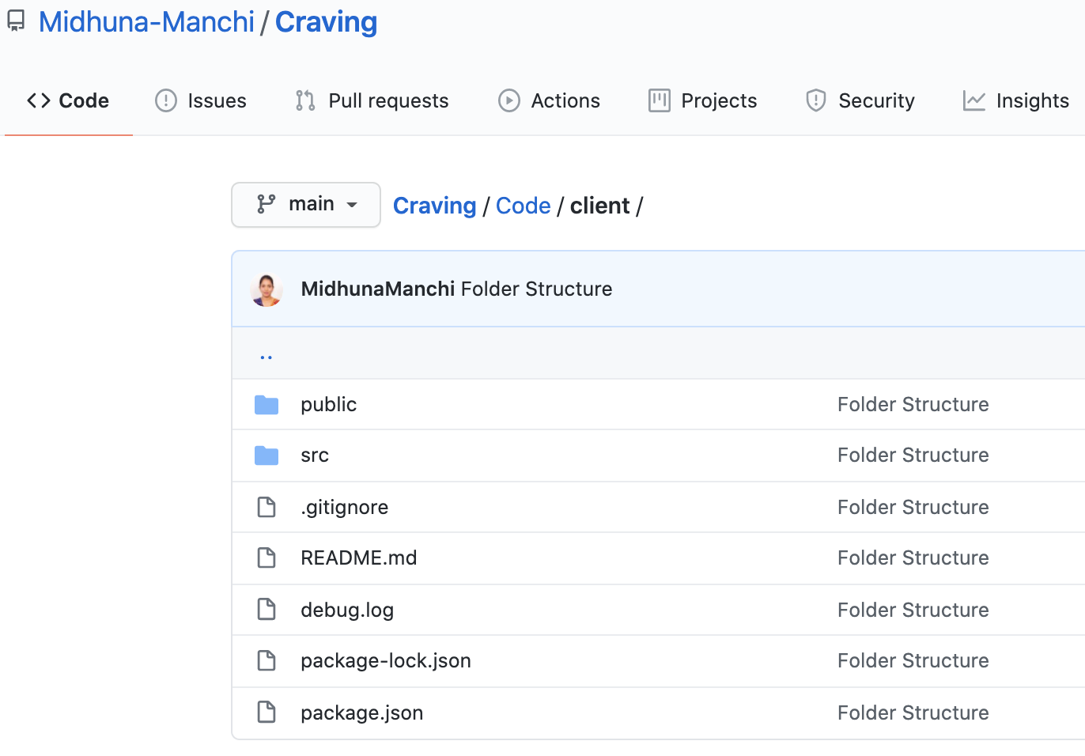
Repository Structure (client)

Slide 6

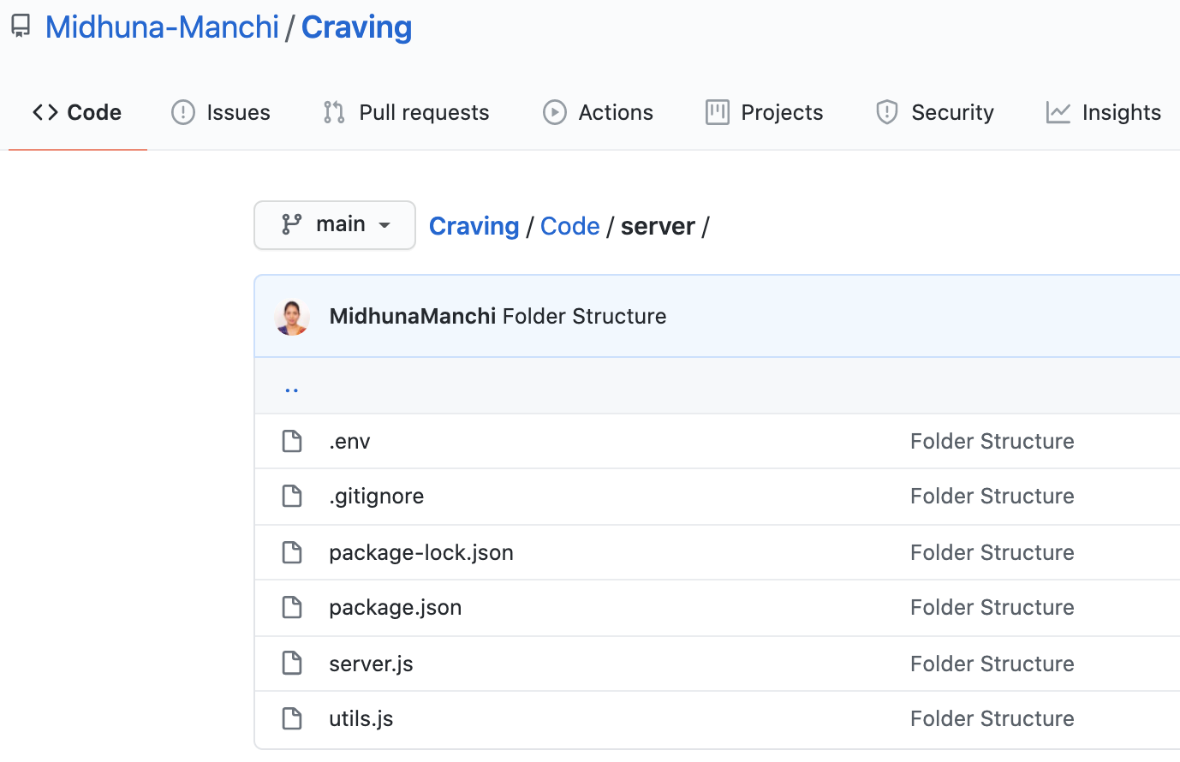
Repository Structure (server)

Slide 7

Build & Deployment
Procedures

Slide 8
Prerequisites:
“
Node.js, React.js and MySQL must be installed on your local machine.

Slide 9

Installation Steps:
Clone this repository to your local machine.
Open the server folder in command line and run the following command: npm install express cors body-parser jsonwebtoken mysql nodemailer nodemon --save
Open the client folder in command line and run the following command: npm install --save react react-router-dom react-native @material-ui/icons axios
Run the sql script in your MySQL client
Check and change the username, password, etc MySQL credentials in server.js in server folder.
Go to server folder in Powershell and enter the following command: nodemon server.js
Go to client folder in Powershell and enter the following command: npm start

Slide 10
Source Code Excerpts

Slide 11

R2 - I3

Slide 12
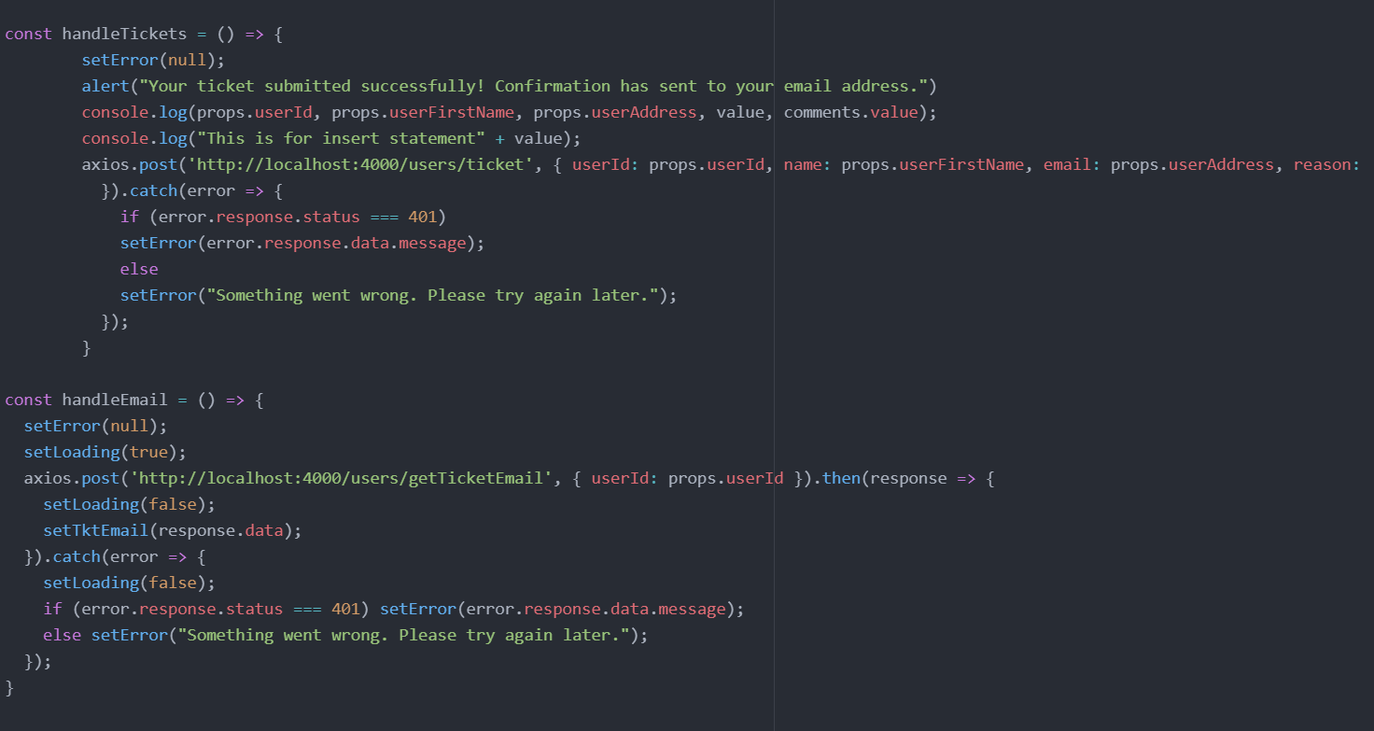
Feature: Ticket Submission

Slide 13
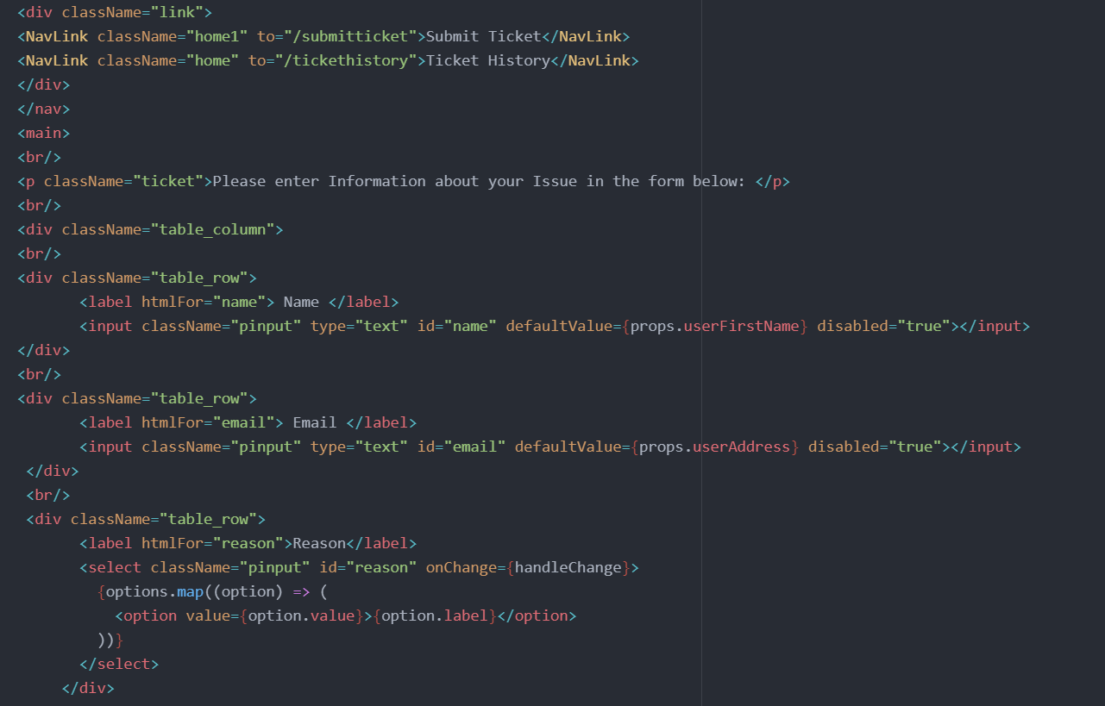

Slide 14
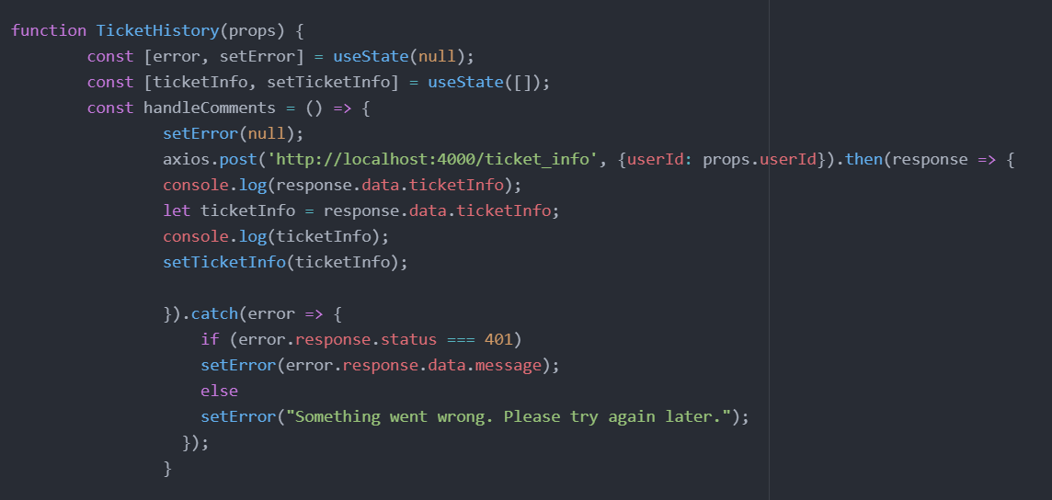
Feature: Ticket history/resolution

Slide 15
R2 - I4

Slide 16
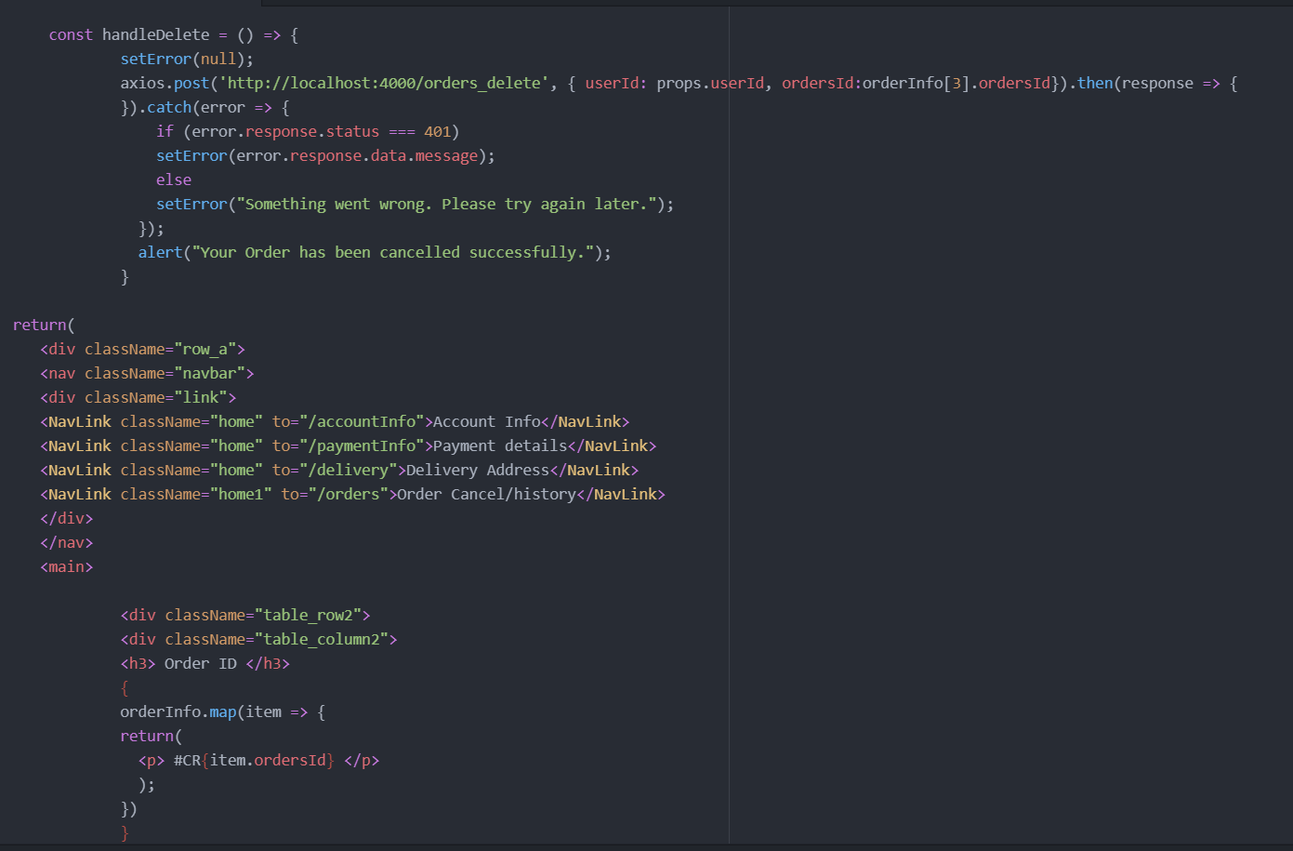
Feature: Order cancel/history

Slide 17
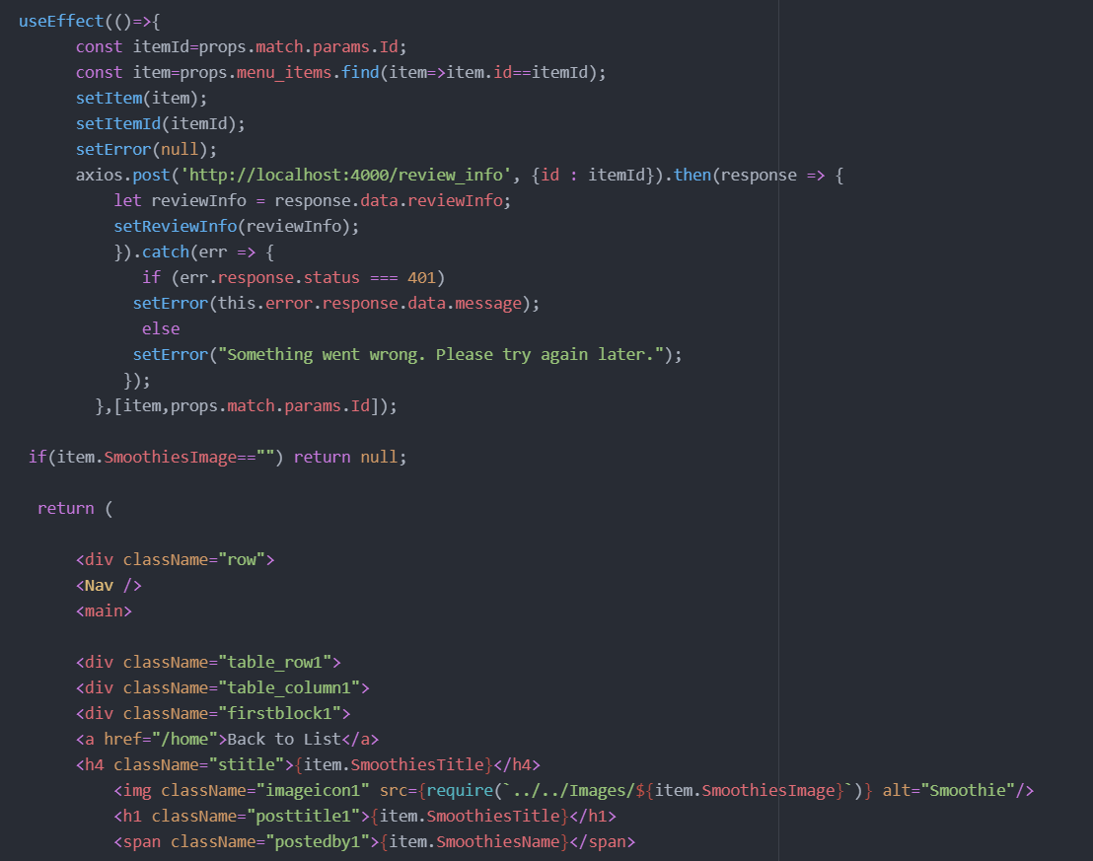
Feature: Leave review

Slide 18
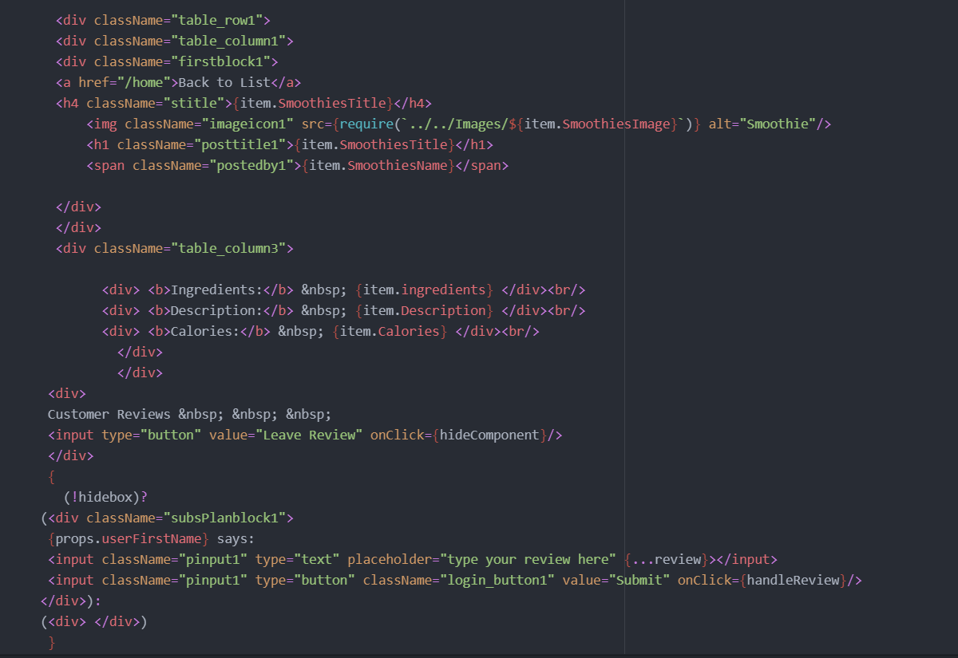

Slide 19

Thank you!

